Slide 1
ITMS 448
Network Penetration
Team Takyon
Daniel Denekew
Michael Kotlyar
Cooper Van Kampen
Henry Post

Slide 2
Video Links
Henry - Command Injection: https://www.youtube.com/watch?v=_IloDqxXu5A
Cooper - HackThisSite: https://drive.google.com/file/d/1DIq_1k6kOCP425HXIVARwL0Iw9HhsfjN/view
Michael - Windows Domains: https://drive.google.com/file/d/1Pt_bA8P8HAoCjfNofwXhUYwVj187gYe0/view
Daniel - TODO: TODO

Slide 3
Cross-site Scripting: Reflected
This vulnerability allows an attacker to inject HTML into a webpage by submitting data that doesn’t get properly inserted into a document.
Don’t just concatenate, encode!

Slide 4
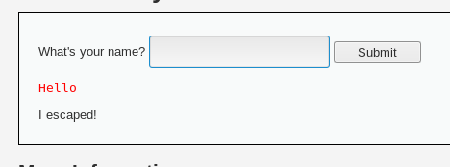
Cross-site Scripting: Reflected

Slide 5
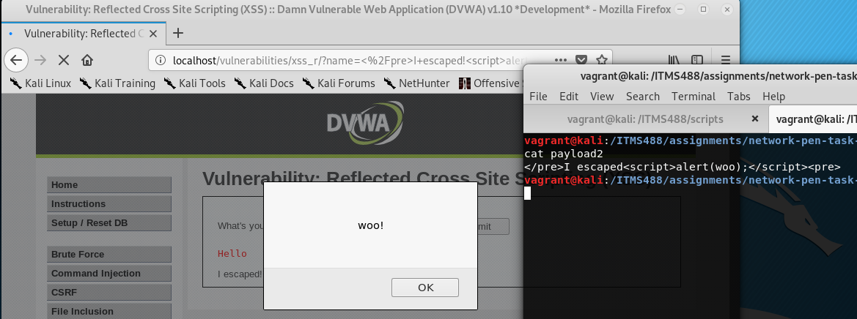
Cross-site Scripting: Reflected

Slide 6
Command Injection
For this vulnerability, we exploited a PHP call to PHP’s `shell_exec` function that accepts user input to execute arbitrary commands.
This is enabled by:
Using `shell_exec` at all (you should avoid it), and
Using user input with `shell_exec` without encoding or sanitizing it.

Slide 7
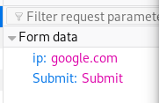
Command Injection: Pre-attack
<?php
if( isset( $_POST[ 'Submit' ] ) ) {
// Get input
$target = $_REQUEST[ 'ip' ];
// Determine OS and execute the ping command.
if( stristr( php_uname( 's' ), 'Windows NT' ) ) {
// Windows
$cmd = shell_exec( 'ping ' . $target );
}
else {
// *nix
$cmd = shell_exec( 'ping -c 4 ' . $target );
}
(...)
This all results in the command `ping -c 4 google.com` being executed.

Slide 8
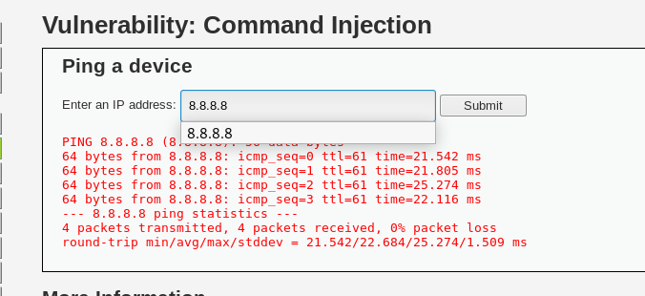
Command Injection: Pre-attack - normal usage :^)

Slide 9
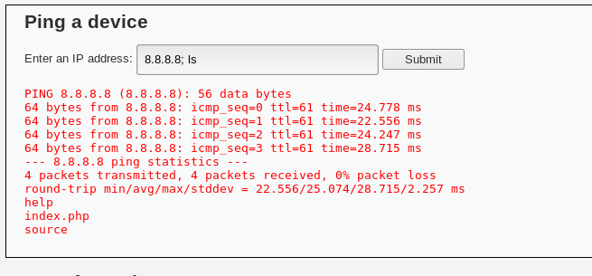
Command Injection: Can we use semicolons? (yes)

Slide 10
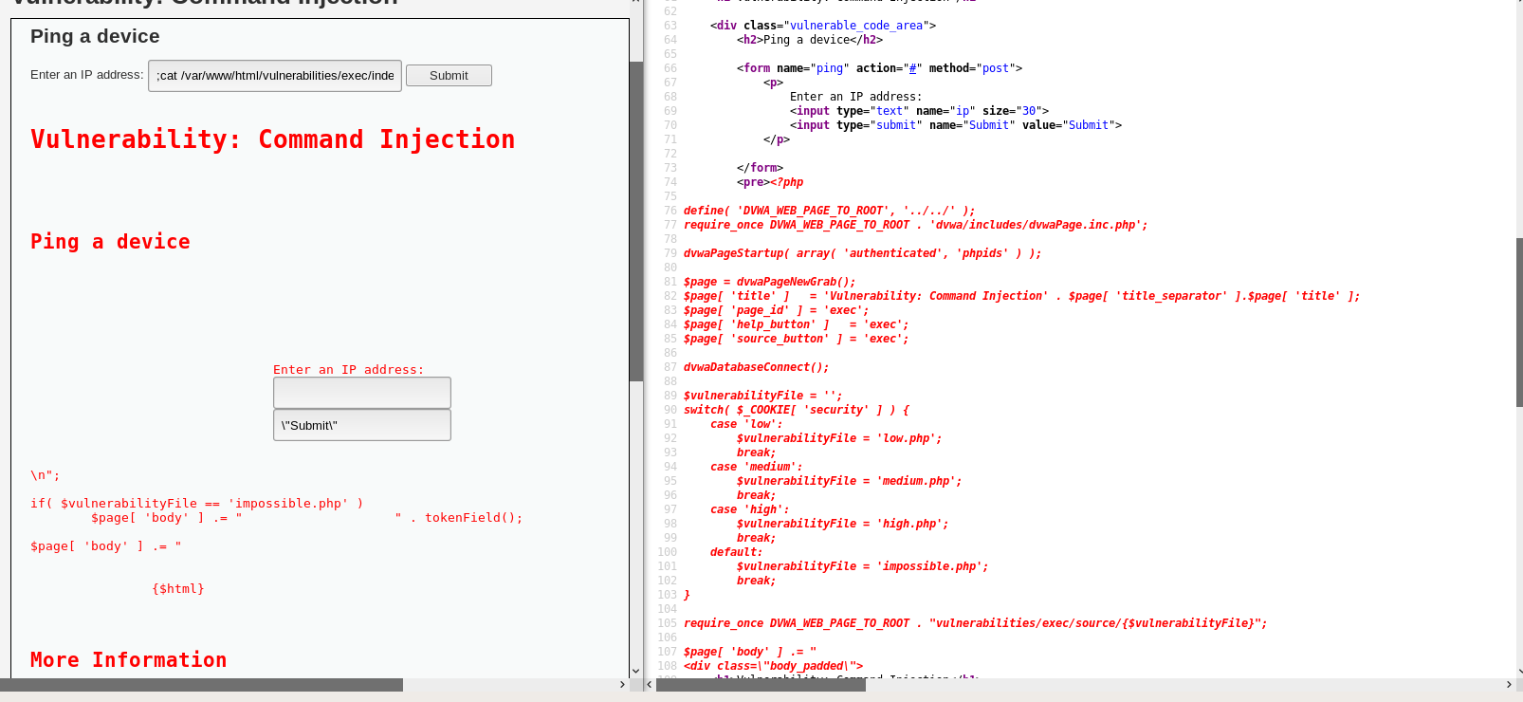
Command Injection: Reading the source code!
;cat /var/www/html/vulnerabilities/exec/index.php

Slide 11
Command Injection: Deleting the site?
Why not? A lot of things are possible with command injection!
Yes, you could delete the site if the current user has WRITE permission to the `www` directory.
A command like ;cd /;rm -rf /var/www/; could remove the /var/www/ directory.
Fortunately, the user executing PHP has write permissions on that directory! Let’s take a look at the results.

Slide 12
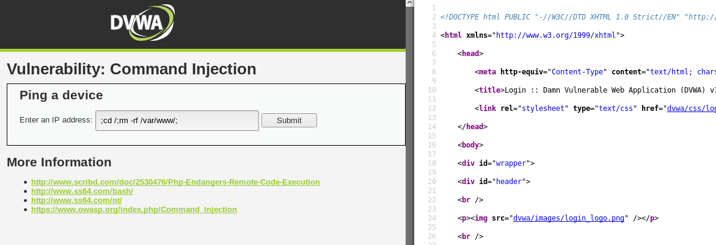
Command Injection: Before the site is gone

Slide 13
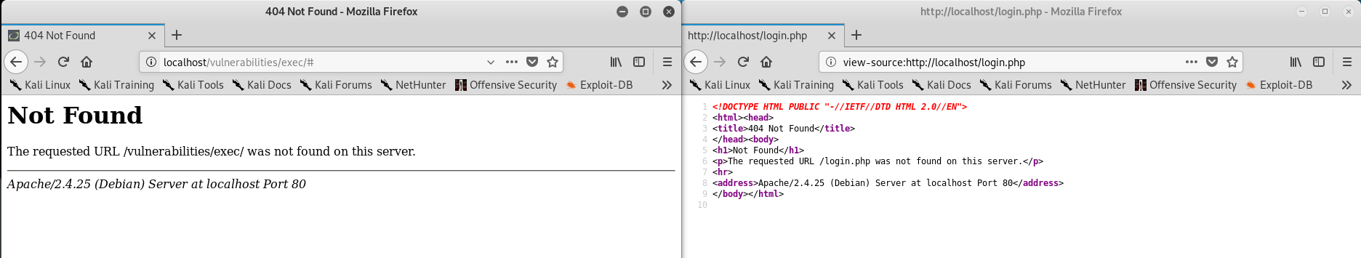
Command Injection: Site’s gone!

Slide 14
File Inclusion
This vulnerability involves allowing a user to pick a file to be displayed, and displaying that file without considering if the file should be displayed.
You can prevent against this by only allowing the user to choose from a LIST of files (i.e. [index.php, about.php, login.php]) and discarding all other input.
Fortunately for us, DVWA is a Damn Vulnerable Web Application, so it has file inclusion vulnerabilities.

Slide 15
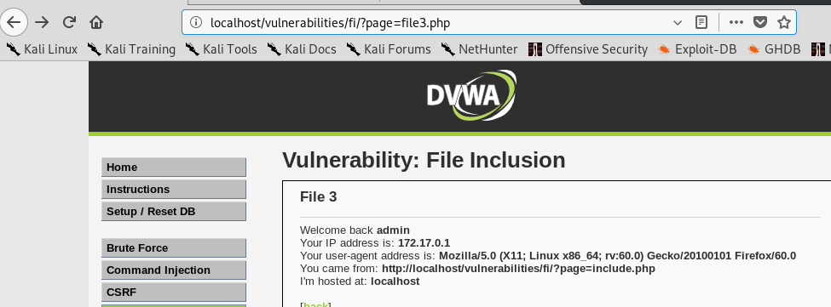
File Inclusion: Before the vulnerability. Hmmm.....

Slide 16
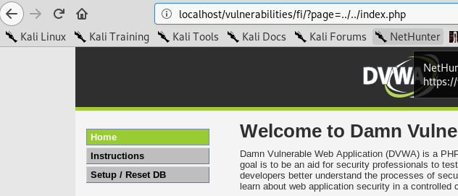
File Inclusion: Relative paths

Slide 17
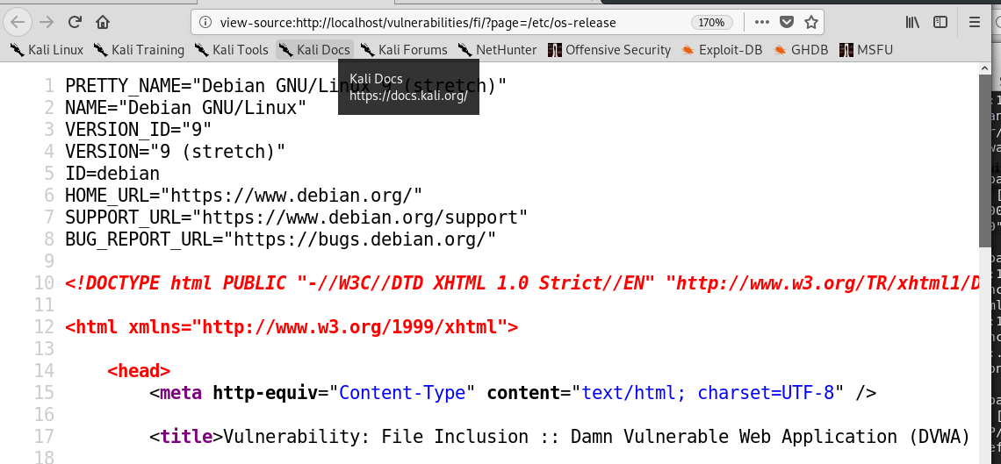
File Inclusion: Absolute paths

Slide 18
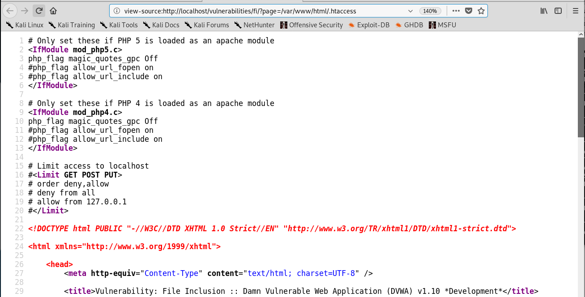
File Inclusion: Absolute paths part 2

Slide 19
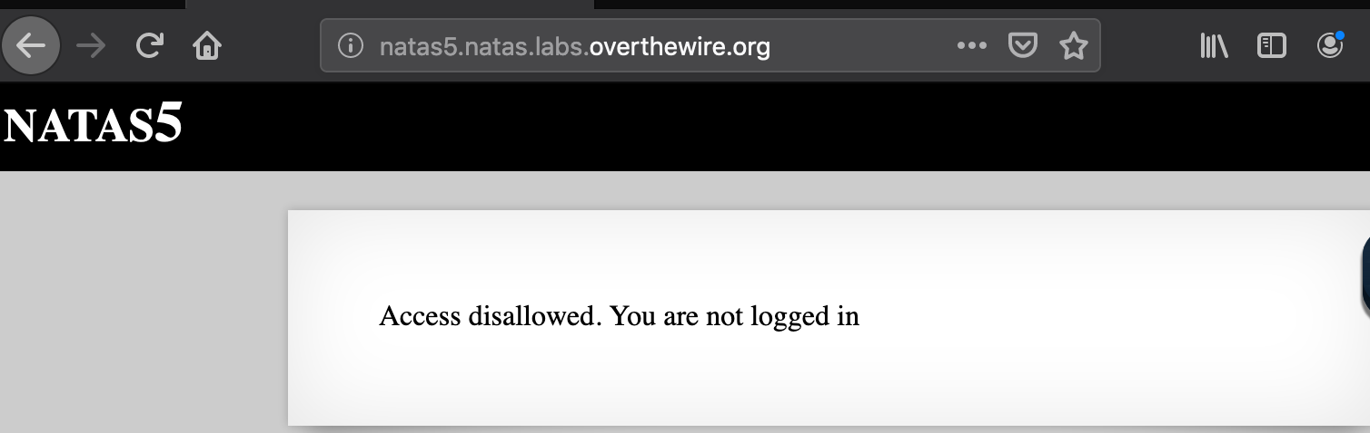
Session Hijacking Using Cookies
Open Burpsuite Proxy
MiTM attack

Slide 20
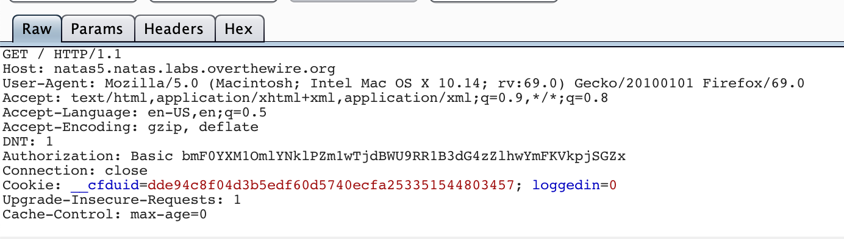
View Cookies (Yum)
What does this mean?
The cookie has a value of Loggedin = 0

Slide 21
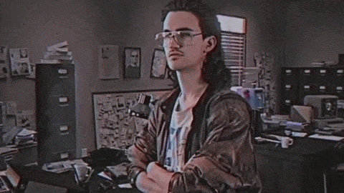
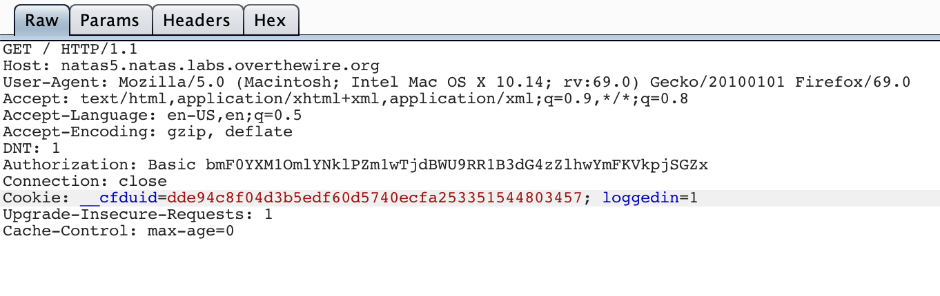
Modify Response
Change Response to 1
Forward Response

Slide 22
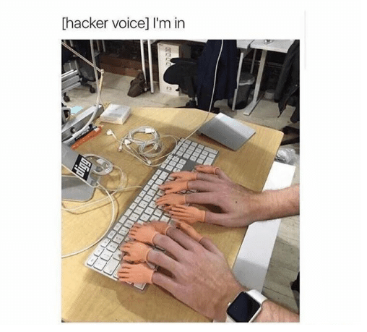
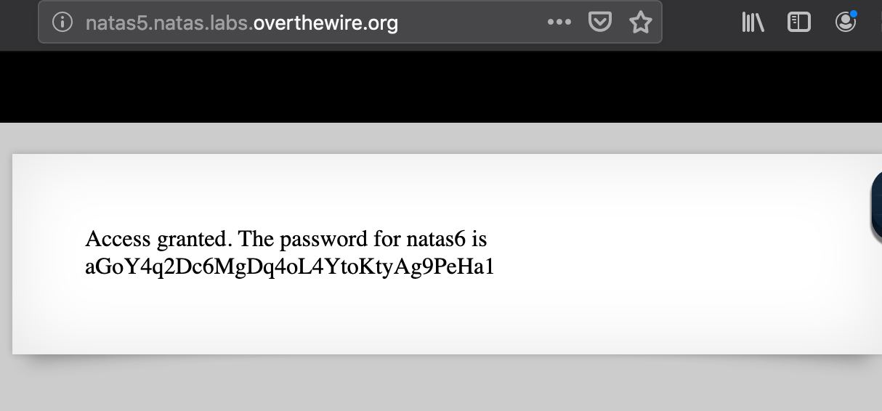
I’m In
Response Accepted!
Login Successful!

Slide 23
MiTM attack in Windows Environment
Requirements:
Rogue Device in on Organization Network
Requires Windows Computer (Victim)
Requires an Organization Domain
File sharing must be on

Slide 24
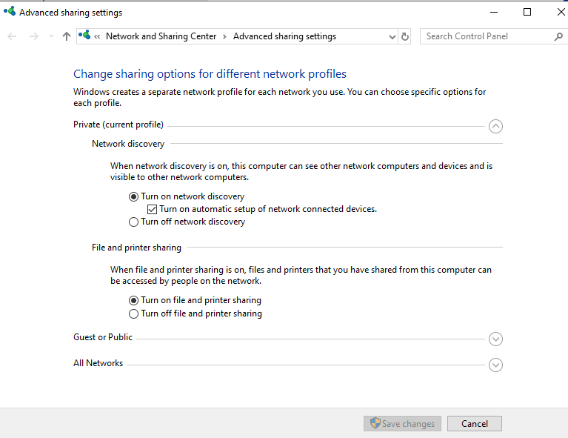
File Sharing Enabled

Slide 25
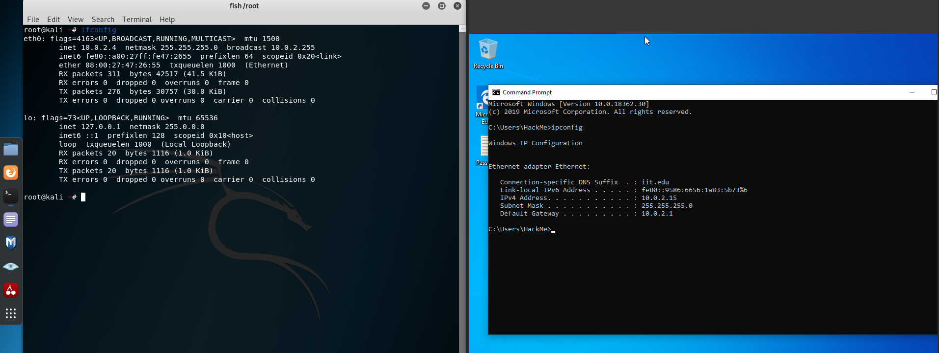
Check Network Configuration

Slide 26
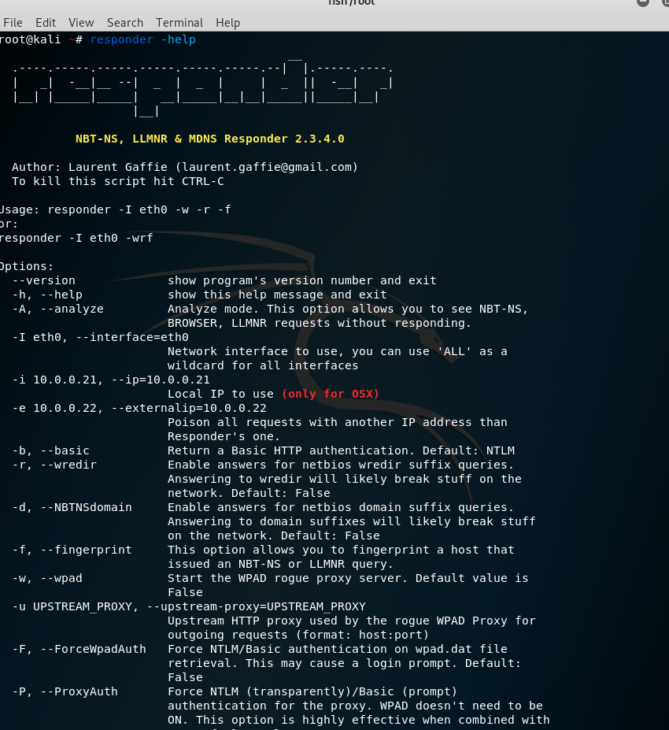
Responder.py
Rogue MiTM tool
Requires Interface
Authentication Responses
-w: wpad server
Web proxy Autodiscover
-r: Netbios Response
-f: Fingerprint
-F: Force WPAD Auth
-P: Proxy Auth
-d: Answer Netbios Queries

Slide 27
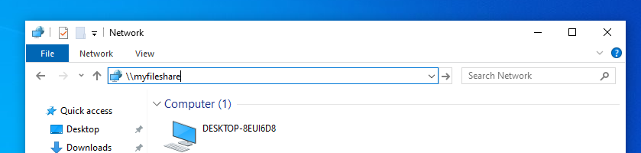
Connect to fileshare
Employee needs to access Network storage right?

Slide 28
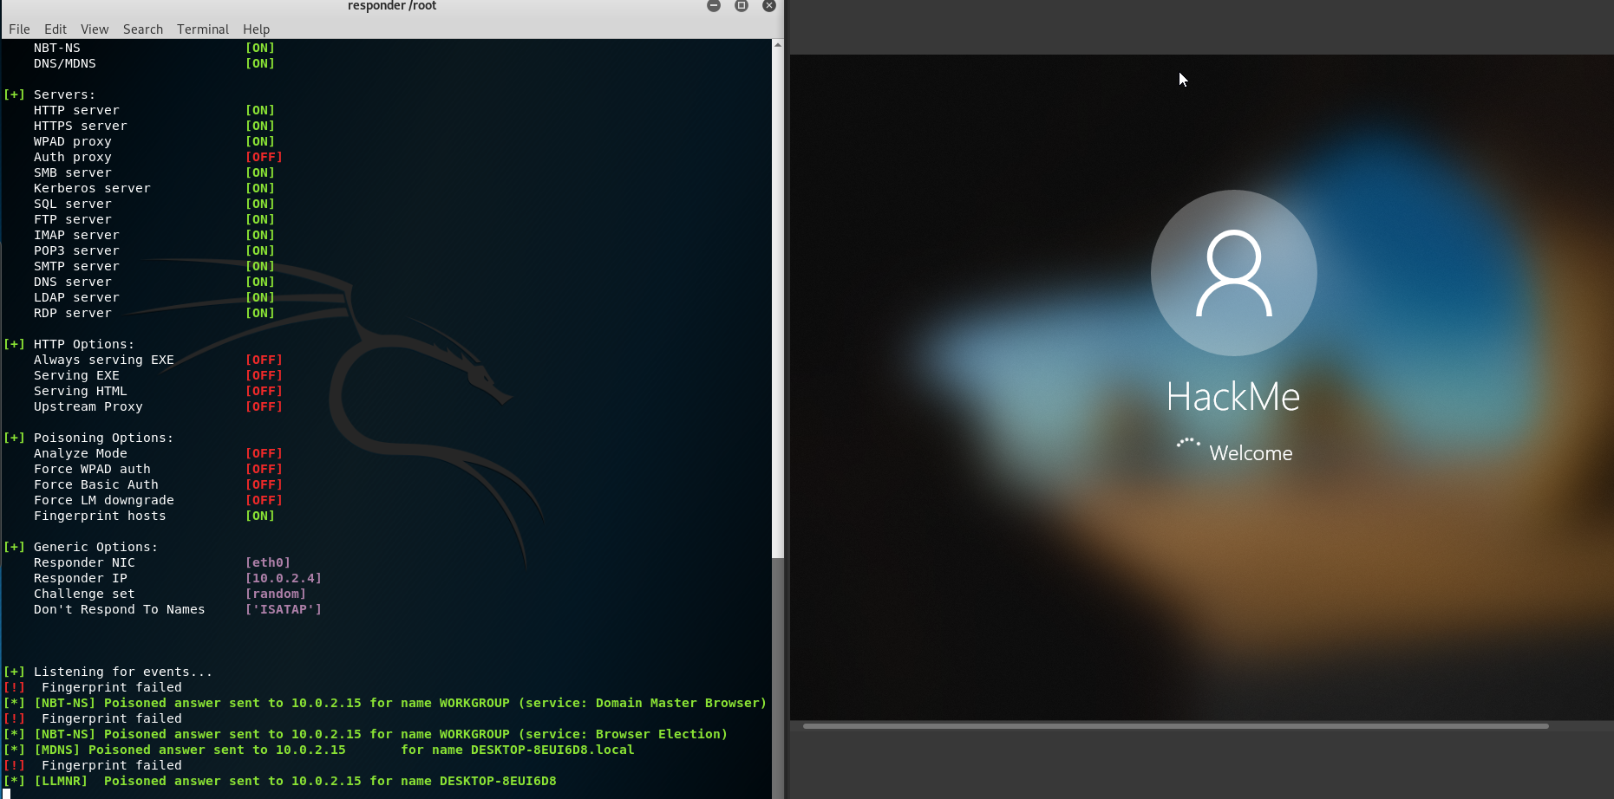
Run command

Slide 29
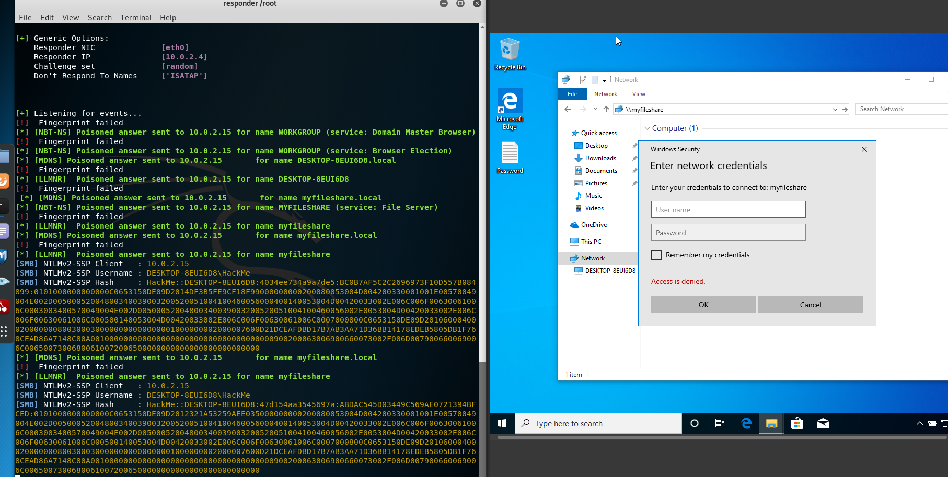
Device Attempts to Connect to Network File Share
User needs to enter Credentials
Needs to “re login”
Actually just gives ha$h

Slide 30
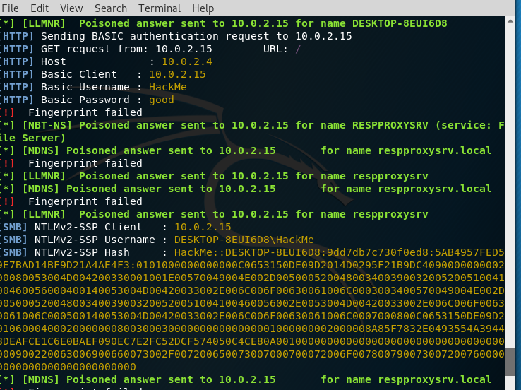
Getting Cleartext Creds
HTTP Server captures credentials in
Cleartext for us
(nice!)

Slide 31
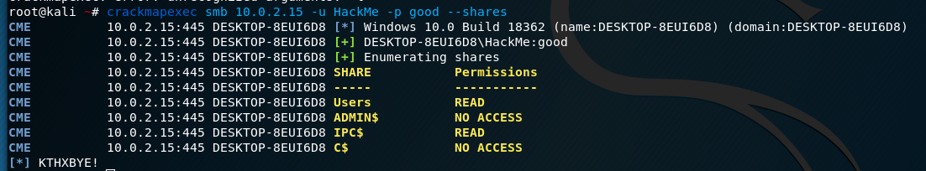
Exploit 3: Pivot/Exploit smb servers
Enumerate network shares
Crackmapexec allows us to view permissions the user has on every computer on the subnet.
We can see what file shares are on each Device, along with Levels of Access

Slide 32
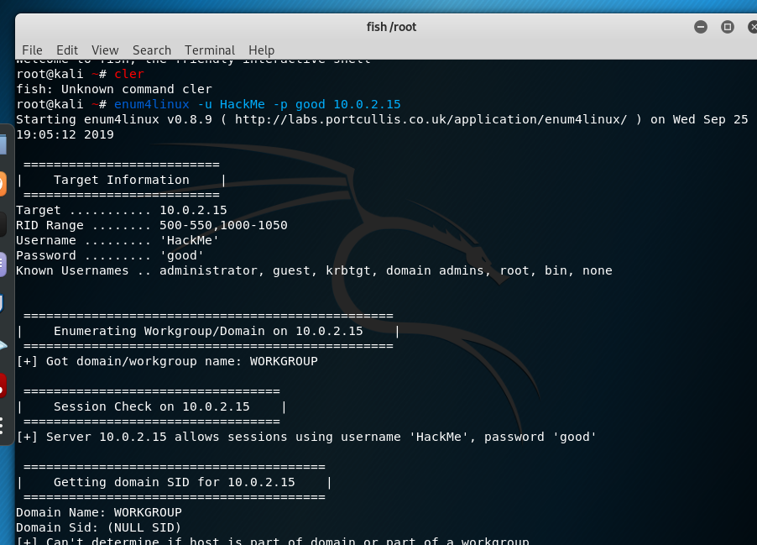
Another Method Of Enumeration
Enum4linux
-u Username
-p Password
- Input IP address range
Do not use this unless you know 100%
This can lock out the user if done wrong

Slide 33
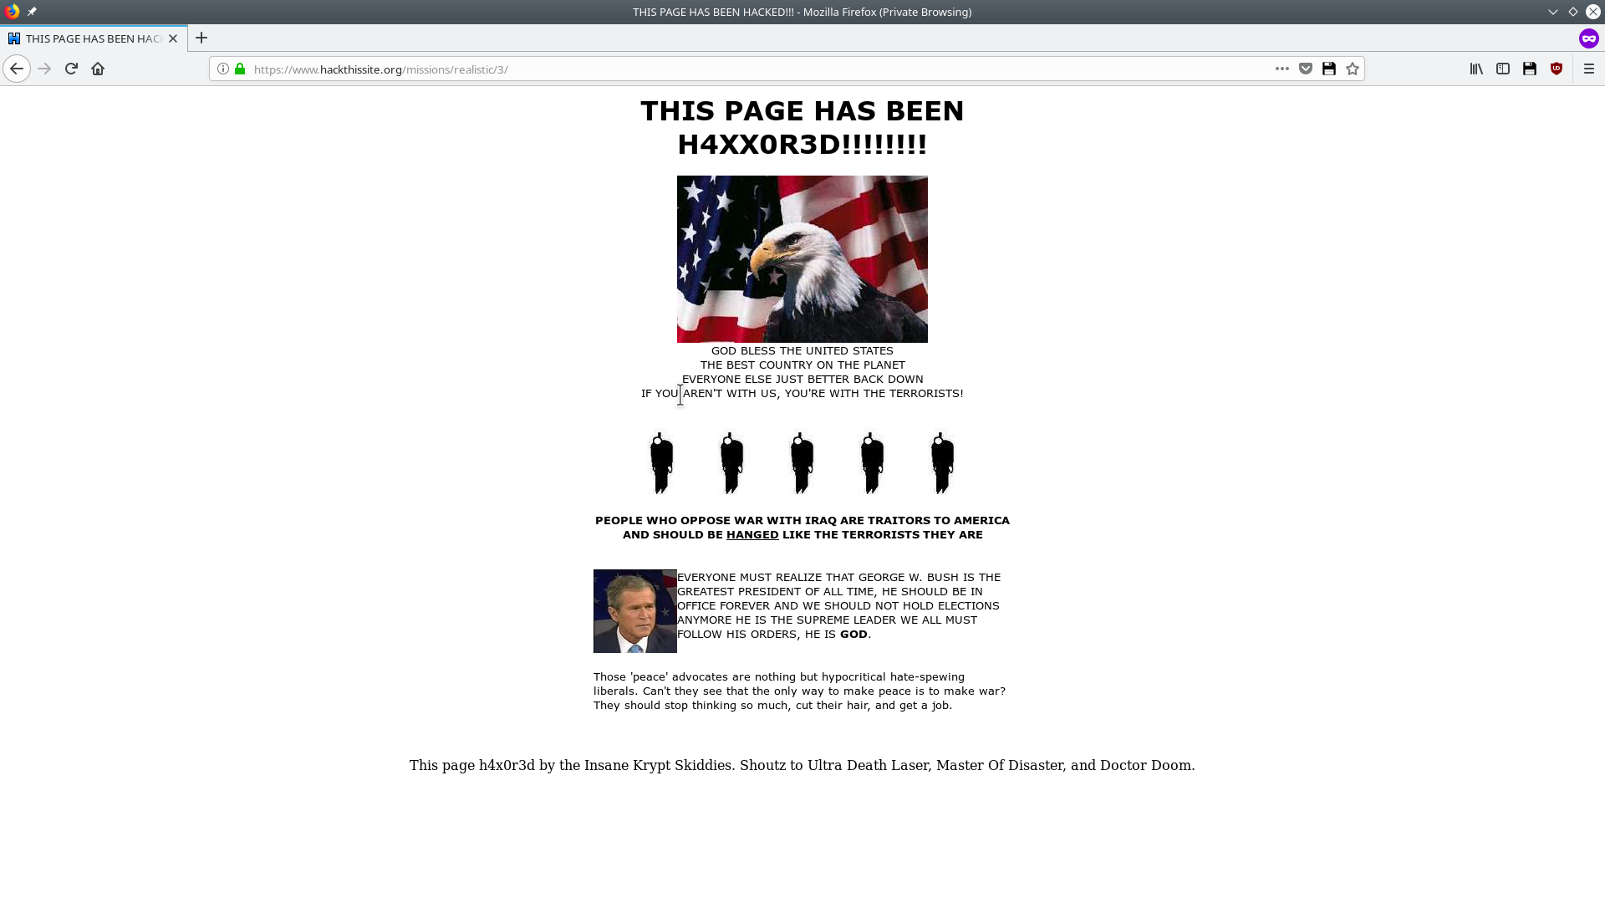
HackThisSite Realistic Mission 3: Peace Poetry
Given page: Uh oh, hacked by pro George Bush extremists!

Slide 34
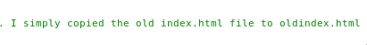
Peace Poetry: Finding the original page
Looking through the page source reveals...

Slide 35
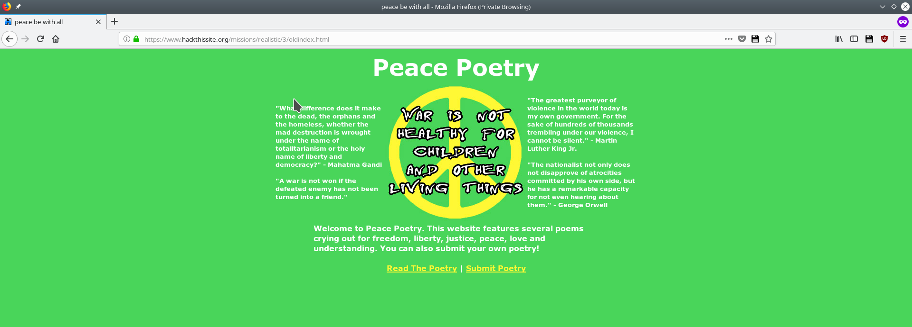
Peace Poetry: The original page
Original page found...what is this, submit poetry?

Slide 36
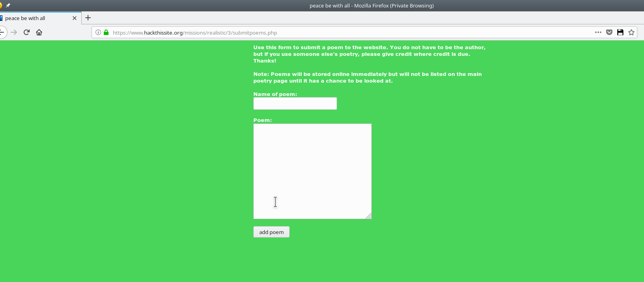
Peace Poetry: Poetry Submission Page
As opposed to a normal file upload, it seems like this has you submit a title to the page of your poem as well as the contents...

Slide 37
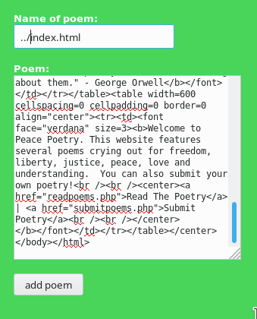
Peace Poetry: The Exploit
Assuming that the submission gets placed in a random directory under the root that we do not have access to (perhaps DOMAIN.TLD/submissions/), we can attempt to replace the root index.html with the desired page available at DOMAIN.TLD/oldindex.html by using a simple parent directory prefix to the submission, and then index.html, and placing the contents as the oldindex.html. If this works, this is how the website was originally hacked.

Slide 38
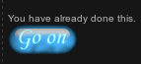
Peace Poetry: Success! File overwrite exploit

Slide 39

HackThisSite Realistic Mission 2: Hack a Nazi
Let’s hack a nazi website, because nobody likes nazis.

Slide 40
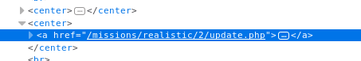
Hack a Nazi
In the source, update.php… interesting

Slide 41
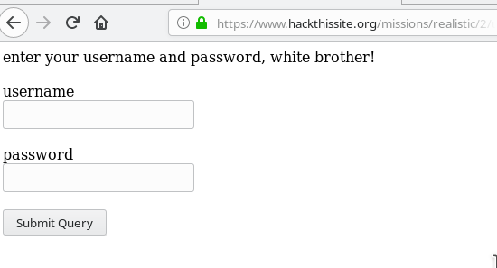
Hack a Nazi: Update.php page
Update.php has some user credentials...interesting

Slide 42
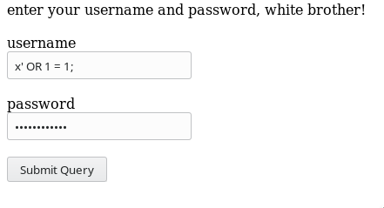
Hack a Nazi: Let’s Try Basic SQLi
A simple x' OR 1 = 1;

Slide 43
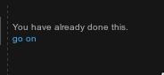
Hack a Nazi: It works!

Slide 44
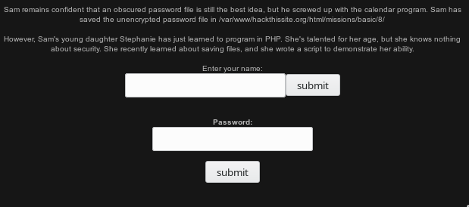
Hack This Site: Basic Level 8
Sam let’s his daughter contribute to his website: Nice, but maybe not so secure...

Slide 45
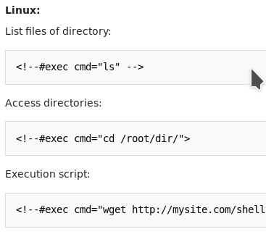
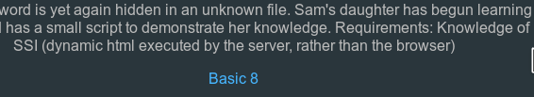
Basic Level 8
HackThisSite hints at us that we need to know about SSI, short for Server Side Includes

Slide 46
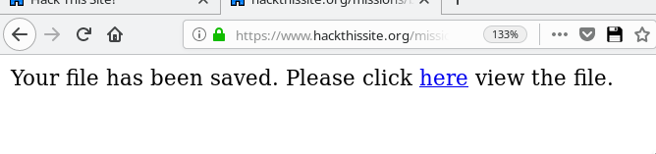
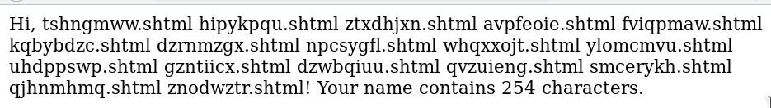
Basic Level 8: Let’s try it
Putting in the ls example from the previous slide into the “Enter your name” field, we get this:

Slide 47
Basic Level 8: Again, but higher!
Ok, now let’s try the parent directory, as the file we would want is there. Then we get….

Slide 48
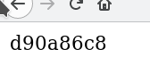
Basic Level 8: Obscurely named file
Because the challenge states “Sam remains confident that an obscured password file is still the best idea”, let’s take a jab at the strangely named au12ha39vc.php ...Interesting, let’s see if it’s the password

Slide 49
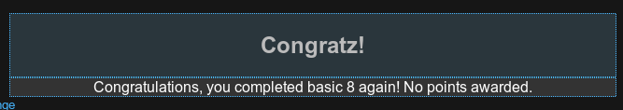
Basic Level 8: Success!
Success! We did it!

Slide 50
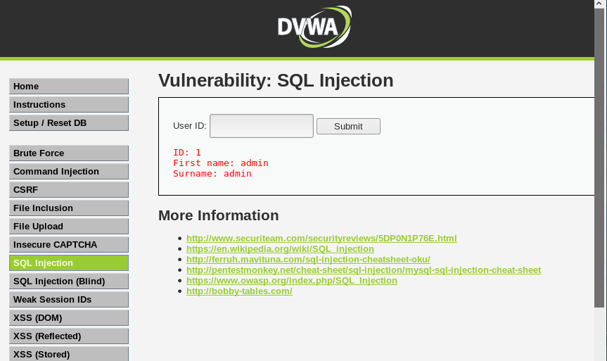
SQL Injection DVWA

Slide 51
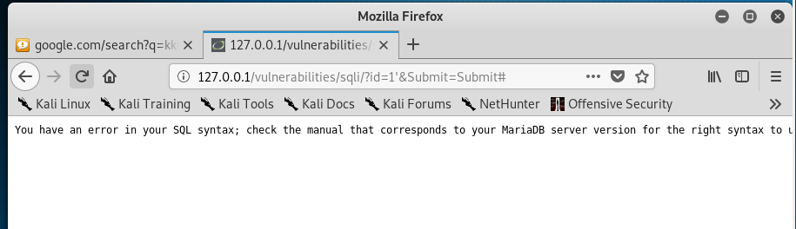
The site is Vulnerable

Slide 52
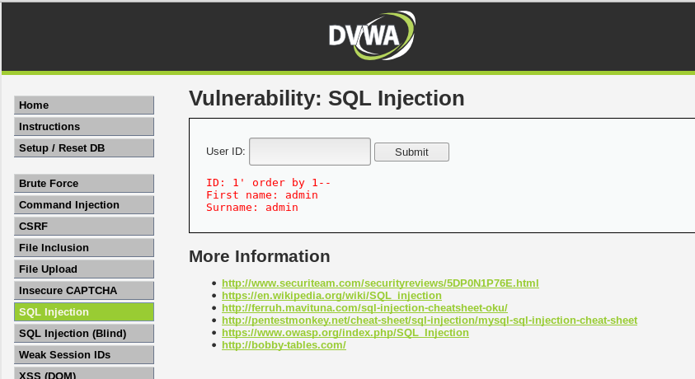
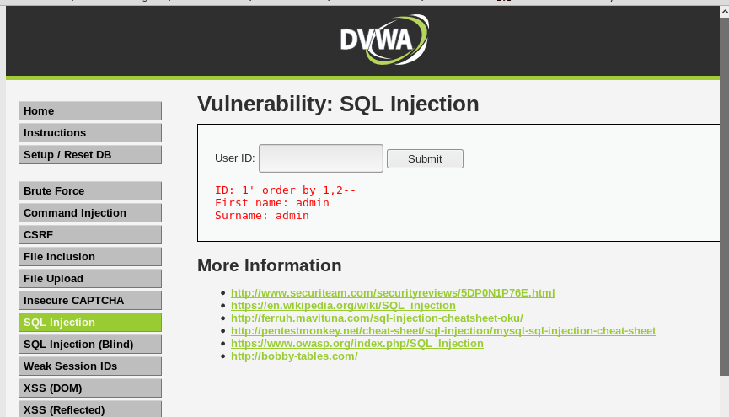
The table has column

Slide 53
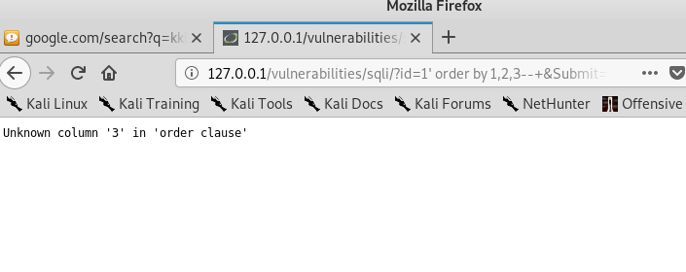
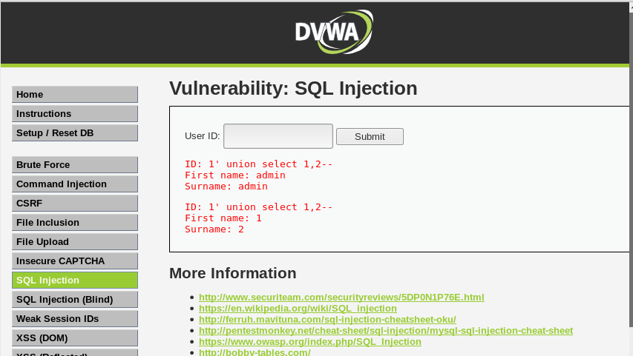
3rd column does not exist

Slide 54


Extracted data & Table from the database

Slide 55


Getting the data and selecting users data

Slide 56


Password encrypt & decrypt

Slide 57


OverTheWire

Slide 58


Getting password

Slide 59


Inspecting the page for PW

Slide 60


Reading Source code

Slide 61


Unlocking Hidden files

Slide 62


Extracting files from hiding code

Slide 63

JS Attack on DVWA

Slide 64

Changing the phrase

Slide 65

Reading the source code

Slide 66

Adding the code on the console

Slide 67

Success

Slide 68
The end!
Questions?
(Bonus slides at the end)

Slide 69



requirements .rst
Obfuscation:
Mask + 10 hacking, +5 onionymous
Gloves +5 hacking, -Fingerprint
Onion +10 layers, +3 routing protocols
Bytes +5 hunger +8 bits

Slide 70

title
title
title

